Slide 1
Smart Contracts And Ride Sharing: A Blockchain Approach To Secure Transportation.
under the guidance of:
t.neelima
21R11A05J0 MKS Gautham
21R11A05H8 M SHASHANK
21R11A05J7 P ANUROOP REDDY

Slide 2
ABSTRACT
The sharing economy has sparked the emergence of innovative businesses that focus on smart city transportation systems.This project aims to explore the potential of integrating blockchain technology into ridesharing services to enhance security and decentralization. Blockchain is a public ledger that enables peer-to-peer transactions without intermediaries, offering a secure anddecentralized solution. The proposed approach involves a blockchain-based framework built on the Ethereum Blockchain that replaces the current centralized system with a decentralized application (DAPP). The use of smart contracts allows for automated transactions, ensuring secure and efficient activity without intermediaries. Smart contracts are implemented using Solidity programming language, and the DAPP uses a minimum matching algorithm to match riders seeking rideshares, minimizing total travel distance. As cryptocurrencies continue to gain popularity, the use of smart contracts in applications, as proposed in this project,has the potential to revolutionize the sharing economy

Slide 3
Blockchain Meets Sharing Economy: A Case of Smart Contract Enabled Ridesharing Service(2022)
Decentralization and Efficiency: The paper proposes a decentralized ridesharing system that eliminates intermediaries, thus reducing service fees and enhancing efficiency in matching riders with drivers.
Improved Security: By leveraging blockchain's characteristics such as immutability and transparency, the proposed system addresses security vulnerabilities associated with centralized models, thereby protecting user data and transactions.
Smart Contract Implementation: The study details the design of smart contracts that automate processes such as user registration, fare calculations, and payment settlements, ensuring a seamless experience for users.
User Trust Enhancement: A peer-to-peer trust evaluation subsystem is introduced to allow users to rate each other after rides, fostering a trustworthy environment that encourages participation in the platform.
Comprehensive System Design: The paper provides detailed implementation insights, including the development tools and smart contract deployment, filling a gap in existing literature regarding practical applications of blockchain in the sharing economy.

Slide 4
INPUTS
The literature on blockchain-enabled ride-sharing solutions highlights the potential of smart contracts to transform traditional transportation systems by enhancing security, transparency, and efficiency. Below are key themes from the existing body of knowledge:
The Need for Decentralized Ride-Sharing Platforms.
Blockchain Fundamentals and Applications in Transportation.
Real-World Implementations and Challenges.
Address gaps in trust mechanisms and explore more user-friendly methods.

Slide 5
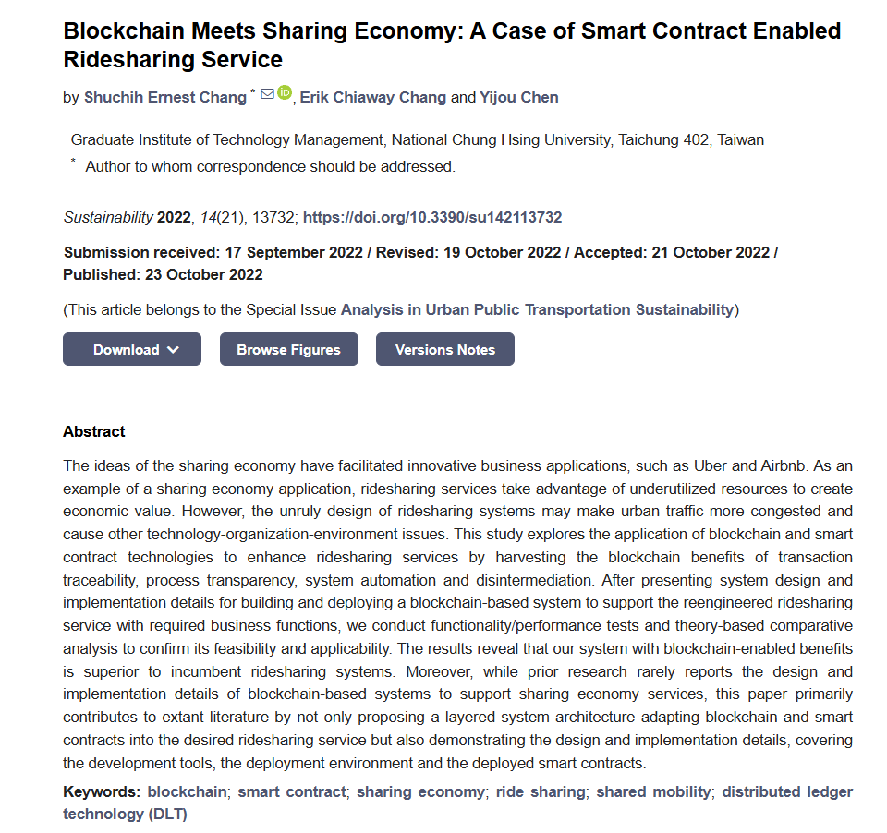

Slide 6
Peer to Peer Ride Sharing Using Blockchain(2024)
Direct User Interaction: This research emphasizes the potential of blockchain to facilitate direct interactions between riders and drivers, eliminating the need for centralized platforms and reducing associated costs.
Enhanced Trust Mechanisms: The study proposes a framework for identity verification using blockchain technology, which helps build trust among users by ensuring that only verified individuals can participate in ridesharing.
Smart Contracts for Automation: It discusses how smart contracts can automate various aspects of the ridesharing process, including fare agreements and payment processing, thus increasing operational efficiency.
Data Privacy Protection: By decentralizing data storage on the blockchain, the research highlights how user privacy can be better protected compared to traditional centralized systems prone to data breaches.
Scalability Considerations: The paper addresses scalability challenges in implementing blockchain-based ridesharing solutions and suggests potential strategies for overcoming these hurdles to ensure widespread adoption.

Slide 7
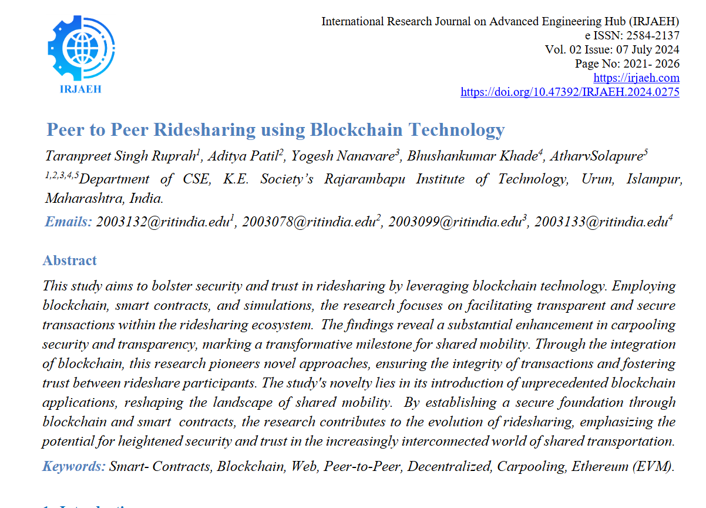

Slide 8
INPUTS
Leverage identity verification techniques and automate ride-sharing processes.
Address scalability in your system design by choosing an appropriate blockchain platform.

Slide 9
Boosting Ridesharing Efficiency Through Blockchain: Greenride Application Case Study(2019)
Application Case Study: This research provides a case study of "Greenride," a blockchain application designed to enhance ridesharing efficiency by optimizing routes and reducing wait times for passengers.
Environmental Sustainability Focus: It emphasizes how blockchain can contribute to more sustainable transportation options by promoting shared rides and reducing individual car usage.
Data-Driven Decision Making: The study highlights how real-time data analytics can be utilized within the blockchain framework to make informed decisions about ride allocation and pricing strategies.
User Engagement Strategies: It discusses methods for engaging users through gamification techniques that reward eco-friendly travel choices made through the platform.
Challenges and Limitations: The paper addresses potential challenges in implementing blockchain technology in ridesharing, including regulatory hurdles and user acceptance issues, while suggesting areas for future research.

Slide 10
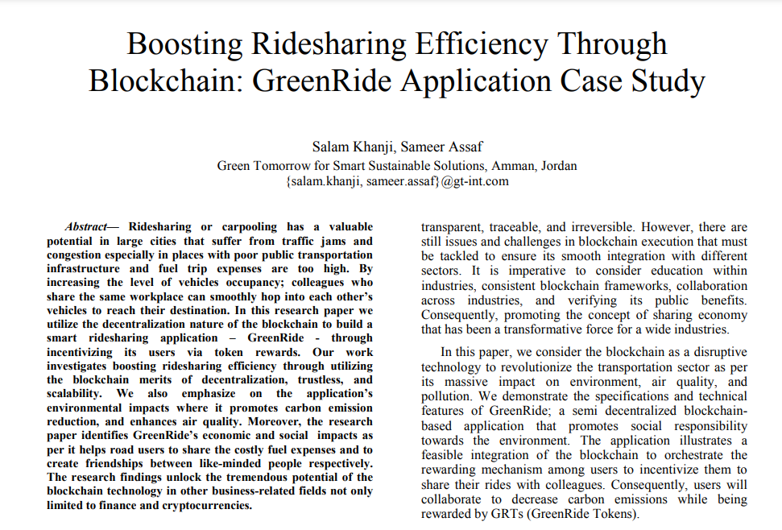

Slide 11
INPUTS
Incorporate real-time data analytics for ride optimization.
Focus on user engagement strategies like gamification to attract users to the platform.

Slide 12
An Introduction to Smart Contracts and Their Potential and Inherent Limitations(2018)
Definition and Functionality: Defines smart contracts as self-executing contracts with the terms written in code, stored on a blockchain.
Legal Considerations: Discusses the enforceability of smart contracts under U.S. contract law and highlights necessary legal considerations for broader adoption.
Automation Benefits: Emphasizes the potential for smart contracts to automate transactions, reducing reliance on intermediaries and lowering execution costs.
Use Cases: Provides examples of practical applications, such as automating payments upon delivery of goods or services.
Challenges Ahead: Identifies challenges related to the integration of smart contracts into existing legal frameworks and the need for clarity in their operational parameters.

Slide 13
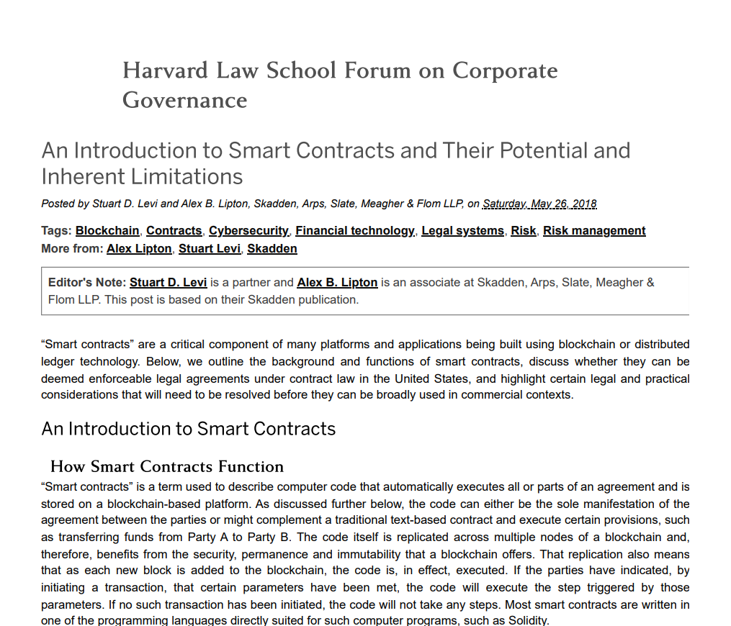

Slide 14
INPUTS
Address legal considerations in the smart contract design.
Ensure flexibility in your implementation for potential future changes.

Slide 15
Decentralised Applications Using Ethereum Blockchain
The paper provides a comprehensive overview of Ethereum, detailing its purpose, functionality, and significance in the blockchain ecosystem. Here are the key points regarding what the paper discusses:
Purpose of Ethereum
Blockchain Architecture
Applications of Ethereum
Future Prospects

Slide 16
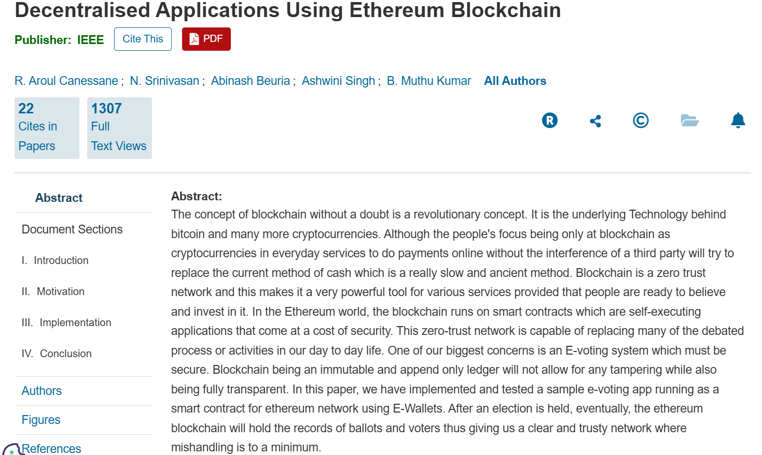

Slide 17
INPUTS
Use Ethereum's robust tools for implementing smart contracts.
Mitigate computational costs and scalability issues by exploring alternatives like layer-2 solutions or other blockchain platforms.

Slide 18
DriveGo - Blockchain Based Peer To Peer Ride Sharing (2023)
The paper titled "DriveGo - Blockchain-Based Peer-to-Peer Ride Sharing" explores the integration of blockchain technology into the ride-sharing industry, focusing on creating a decentralized platform that enhances security, transparency, and user experience.
Scalability Issues
High Computational Costs
User Adoption Challenges

Slide 19
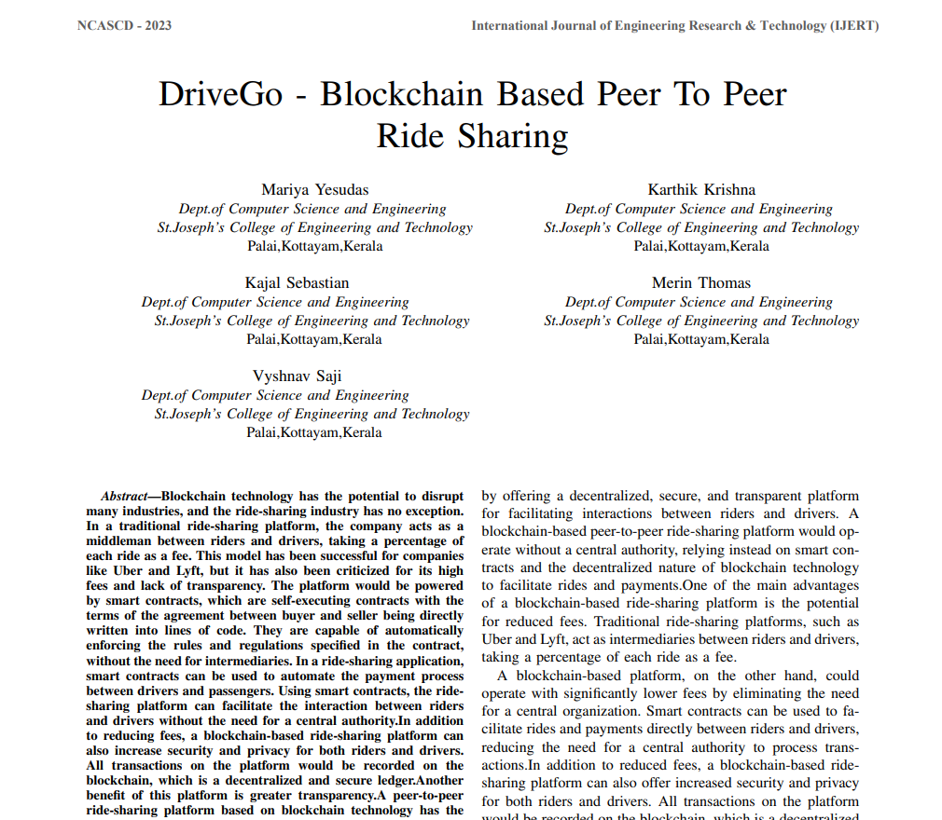

Slide 20
INPUTS
Build a user-friendly interface to improve adoption rates.
Prioritize solving scalability issues through modular and flexible design.

Slide 21
SUMMARY
Smart Contract Design:
Use insights from reviewed papers to design automated contracts for registration, payments, and fare calculations.
Decentralized Architecture:
Eliminate intermediaries to ensure cost reduction and enhance trust.
Scalability Solutions:
Address blockchain scalability by using efficient frameworks or alternative platforms.
User-Centric Features:
Implement identity verification and gamification techniques for higher engagement.
Data Analytics Integration:
Use real-time analytics for efficient ride allocation and environmentally sustainable practices.

Slide 22
REFERENCES
https://www.mdpi.com/2071-1050/14/21/13732
https://doi.org/10.47392/IRJAEH.2024.0275
https://www.academia.edu/38956576/Boosting_Ridesharing_Efficiency_Through_Blockchain_GreenRide_Application_Case_Study
https://corpgov.law.harvard.edu/2018/05/26/an-introduction-to-smart-contracts-and-their-potential-and-inherent-limitations/
https://ieeexplore.ieee.org/document/8918887
https://www.ijert.org/research/drivego-blockchain-based-peer-to-peer-ride-sharing-IJERTCONV11IS04030.pdf

Slide 23
THANK YOU

